Slide 1

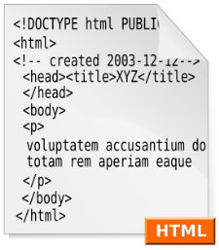



Web Technologies Basics
WWW, HTTP, GET, POST, Cookies
Svetlin Nakov
Telerik Corporation
www.telerik.com

Slide 2

Table of Contents
WWW and the HTTP protocol
  The HTTP protocol
  The request-response model
  GET vs. POST methods
  HTTP Response Codes
Cookies
Web Development Tools

Slide 3
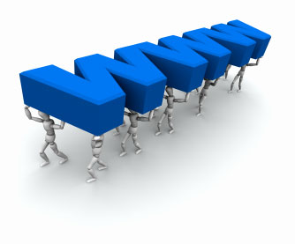


WWW and HTTP
HTTP Protocol: the Heart of the WWW

Slide 4
What is WWW?
WWW = World Wide Web = Web
  Global distributed information system in Internet
    A service in Internet (like E-mail, DNS, ...)
  Consists of set of documents (and other resources) located on different Internet servers
    Accessed through standard protocols like HTTP, HTTPS and FTP by their URL
  Web servers provide Web content
  Web browsers display the Web content

Slide 5
WWW Components
Structural components
  Internet – provides data transfer channels over the TCP and HTTP protocols
  Clients (Web browsers) – display Web content
  Web servers – IIS, Apache, Tomcat, GWS, etc.
Semantic components
  Hyper Text Transfer Protocol (HTTP)
  Hyper Text Markup Language (HTML)
  Uniform Resource Locator (URL)
    Uniform Resource Identifiers (URIs)

Slide 6
WWW Infrastructure
Clients use Web browser application to request resources from the Web servers via HTTP
  Resources have unique URL address
Servers send the requested resource as a response
  Or reply with an error message
Web pages are resources in WWW
  HTML text, graphics, animations and other files
Web sites
  Web sites are sets of Web pages in WWW

Slide 7
WWW Infrastructure (2)
Client’s browser renders Web pages returned by the Web servers
  Pages are in HTML (Hyper Text Markup Language)
  Browsers shows the text, graphics, sounds, etc.
  HTML pages contain hyperlinks to other pages
The entire WWW system runs over standard networking protocols
  TCP, DNS, HTTP, FTP, …
The HTTP protocol is fundamental for WWW

Slide 8
Main Components of WWW: URL
Uniform Resource Locator (URL)
  Unique resource location in WWW, e.g.
It is just a formatted string, consisting of:
  Protocol for communicating with the server (e.g., http, ftp, https, ...)
  Name of the server or IP address + optional port (e.g. www.telerik.com, mail.bg:8080)
  Path and name of the resource (e.g. index.php)
  Parameters (optional, e.g. ?id=27&lang=en)
http://www.telerik.com/academy/winter-2009-2010.aspx

Slide 9
URL Encoding
URLs are encoded according RFC 1738:
All other characters are escaped with the formula:
  Example: space has decimal code 32, in hex – 20, so space in URL becomes %20
  Space can also be encoded as "+"
“... Only alphanumeric [0-9a-zA-Z], the special characters $-_.+!*'() and reserved characters used for their reserved purposes may be used unencoded within an URL.”
%[character hex code in ISO-Latin character set]

Slide 10
URL – Examples
Some valid URLs:
Some invalid URLs:
http://www.google.bg/search?sourceid=navclient&ie=UTF-8&rlz=1T4GGLL_enBG369BG369&q=http+get+vs+post
http://bg.wikipedia.org:80/wiki/%D0%A2%D0%B5%D0%BB%D0%B5%D1%80%D0%B8%D0%B3
Should be: ?q=C%23+.NET+4.0
http://www.google.bg/search?&q=C# .NET 4.0
Should be: ?q=%D0%B1%D0%B8%D1%80%D0%B0
http://www.google.bg/search?&q=бира

Slide 11
Main Components of WWW: HTML
Hyper Text Markup Language (HTML)
  Notation for describing formatted text with images and hyperlinks
  Interpreted and displayed by the Web browsers
A Web (HTML) page consists of:
  HTML file
  CSS stylesheet file (optional)
  A bunch of images (optional)
  Other resources (optional)

Slide 12
Main Components of WWW: HTML
HTML is straight-forward and easy to learn
  HTML documents are plain text files
    Easy to add formatting, hyperlinks, bullets, etc.
    Images can be added as separate files
  Can be automatically generated by authoring programs
    Tools to help users creating HTML pages
    E.g. FrontPage, Dreamweaver, Visual Studio
    WYSIWYG HTML editors

Slide 13
HTML – Example
<html>
<head><title>HTML Example</title></head>
<body>
<h1>Heading 1</h1>
<h2>Sub heading 2</h2>
<h3>Sub heading 3</h3>
<p>This is my first paragraph</p>
<p>This is my second paragraph</p>
<div align="center"
style="background:skyblue">
This is a div</div>
</body>
</html>

Slide 14
Main Components of WWW: HTTP
Hyper Text Transfer Protocol (HTTP)
  Client-server protocol for transferring Web resources (HTML files, images, styles, etc.)
Important properties of HTTP
  Request-response model
  Text-based format
  Relies on a unique resource URLs
  Provides resource metadata (e.g. encoding)
  Stateless (cookies can overcome this)

Slide 15


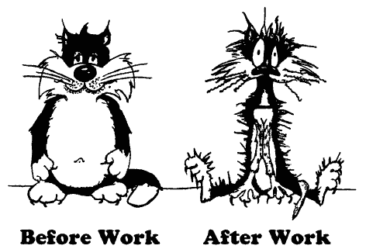
The HTTP Protocol
How HTTP Works?
HTTP

Slide 16
HTTP: Request-Response Protocol
Client program
  Running on end host
  E.g. Web browser
  Requests a resource
Server program
  Running at the server
  E.g. Web server
  Provides resources
GET /index.html
HTTP/1.0
HTTP/1.0 200 OK
"Welcome to our
Web site!"
16

Slide 17
Example: Hyper Text Transfer Protocol
HTTP request:
GET /academy/about.aspx HTTP/1.1
Host: www.telerik.com
User-Agent: Mozilla/5.0
<CRLF>
The empty line denotes the end of the request header
HTTP response:
HTTP/1.1 200 OK
Date: Mon, 5 Jul 2010 13:09:03 GMT
Server: Microsoft-HTTPAPI/2.0
Last-Modified: Mon, 12 Jul 2010 15:33:23 GMT
Content-Length: 54
<CRLF>
<html><title>Hello</title>
Welcome to our site</html>
The empty line denotes the end of the response header

Slide 18
HTTP Request Message
Request message sent by a client consists of
  Request line – request method (GET, POST, HEAD, ...), resource URI, and protocol version
  Request headers – additional parameters
  Body – optional data
    E.g. posted form data, files, etc.
<request method> <resource> HTTP/<version>
<headers>
<empty line>
<body>

Slide 19
HTTP GET Request – Example
Example of HTTP GET request:
GET /academy/winter-2009-2010.aspx HTTP/1.1
Host: www.telerik.com
Accept: */*
Accept-Language: bg
Accept-Encoding: gzip, deflate
User-Agent: Mozilla/4.0(compatible;MSIE 6.0; Windows NT 5.0)
Connection: Keep-Alive
Cache-Control: no-cache
<CRLF>
HTTP request line
HTTP headers
The request body is empty

Slide 20
HTTP POST Request – Example
Example of HTTP POST request:
POST /webmail/login.phtml HTTP/1.1
Host: www.abv.bg
Accept: */*
Accept-Language: bg
Accept-Encoding: gzip, deflate
User-Agent: Mozilla/4.0(compatible;MSIE 6.0; Windows NT 5.0)
Connection: Keep-Alive
Cache-Control: no-cache
Content-Length: 59
<CRLF>
LOGIN_USER=mente
DOMAIN_NAME=abv.bg
LOGIN_PASS=top*secret!
<CRLF>
HTTP request line
HTTP headers
The request body contains the submitted form data

Slide 21
Conditional HTTP GET – Example
Example of HTTP conditional GET request:
GET /academy/join.aspx HTTP/1.1
Host: www.telerik.com
User-Agent: Gecko/20100115 Firefox/3.6
If-Modified-Since: Tue, 9 Mar 2010 11:12:23 GMT
<CRLF>
Fetches the resource only if it has been changed at the server
  Server replies with “304 Not Modified” if the resource has not been changed
  Or “200 OK” with the latest version otherwise

Slide 22
HTTP Response Message
Response message sent by the server
  Status line – protocol version, status code, status phrase
  Response headers – provide meta data
  Body – the contents of the response (the requested resource)
HTTP/<version> <status code> <status text>
<headers>
<CRLF>
<response body – the requested resource>

Slide 23
HTTP Response – Example
Example of HTTP response from the Web server:
HTTP response status line
HTTP/1.1 200 OK
Date: Fri, 17 Jul 2010 16:09:18 GMT+2
Server: Apache/2.2.14 (Linux)
Accept-Ranges: bytes
Content-Length: 84
Content-Type: text/html
<CRLF>
<html>
<head><title>Test</title></head>
<body>Test HTML page.</body>
</html>
HTTP response headers
The HTTP response body

Slide 24
HTTP Response – Example
Example of HTTP response with error result:
Response status line
HTTP/1.1 404 Not Found
Date: Fri, 17 Jul 2010 16:09:18 GMT+2
Server: Apache/2.2.14 (Linux)
Connection: close
Content-Type: text/html
<CRLF>
<HTML><HEAD>
<TITLE>404 Not Found</TITLE>
</HEAD><BODY>
<H1>Not Found</H1>
The requested URL /img/telerik-logo.gif was not found on this server.<P>
<HR><ADDRESS>Apache/2.2.14 Server at Port 80</ADDRESS>
</BODY></HTML>
HTTP response headers
The HTTP response body

Slide 25
Content-Type and Disposition
The Content-Type header at the server specifies how the output should be processed
Examples:
UTF-8 encoded HTML page. Will be shown in the browser.
Content-Type: text/html; charset=utf-8
Content-Type: application/pdf
Content-Disposition: attachment;
filename="Financial-Report-April-2010.pdf"
This will download a PDF file named Financial-Report-April-2010.pdf

Slide 26
HTTP Request Methods
HTTP request methods:
  GET
    Return the specified resource, run a program at the server, or just download file, …
  HEAD
    Return the meta-data associated with a resource (headers only)
  POST
    Update a resource, provide input data for processing at the server, …

Slide 27
HTTP Response Codes
HTTP response code classes
  1xx: informational (e.g., “100 Continue”)
  2xx: success (e.g., “200 OK”)
  3xx: redirection (e.g., “304 Not Modified”, "302 Found")
  4xx: client error (e.g., “404 Not Found”)
  5xx: server error (e.g., “503 Service Unavailable”)
"302 Found" is used for redirecting the Web browser to another URL

Slide 28
Browser Redirection
HTTP browser redirection example
  HTTP GET requesting a moved URL:
  The HTTP response says the browser should request another URL:
GET / HTTP/1.1
Host: academy.telerik.com
User-Agent: Gecko/20100115 Firefox/3.6
<CRLF>
HTTP/1.1 301 Moved Permanently
Location: http://www.telerik.com/academy/
…

Slide 29
HTTP Cookies
Cookie
  Cookies are small pieces of data stored by the client on behalf of the server
  Included in all future HTTP requests to the server
Request
Response
Set-Cookie: XYZ
Next request
Cookie: XYZ

Slide 30
Cookies – Example
The client requests some URL:
The server sets a cookie in the HTTP response:
In further requests to google.bg the Web browser sends the cookie in the HTTP header:
GET / HTTP/1.1
Host: www.google.bg
HTTP/1.1 200 OK
Set-Cookie: PREF=ID=c0bf5fd5c3a25209; expires=Wed, 11-Jul-2012 16:13:22 GMT; domain=.google.bg
GET / HTTP/1.1
Host: www.google.bg
Cookie: PREF=ID=c0bf5fd5c3a25209

Slide 31
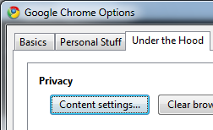
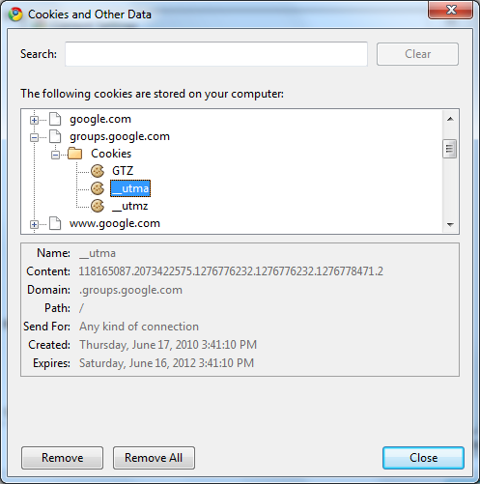
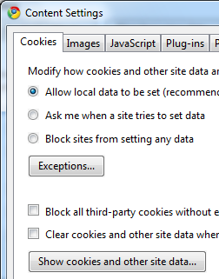
View Cookies in the Web Browser

Slide 32


HTTP Developer Tools
Firebug plug-in for Firefox
  A must have for Web developers
  The ultimate tool for monitoring, editing and debugging HTTP, HTML, CSS, JavaScript, etc.
  Free, open-source – www.getfirebug.com
Fiddler – HTTP proxy
  Intercepts the HTTP traffic
  Analyzes the HTTP conversation
  Free tool – www.fiddler2.com

Slide 33

HTTP Developer Tools (2)
Wireshark packet analyzer
  Low-level packet sniffer
  Intercepts the entire IP network traffic
  Can reconstruct the HTTP conversation
  Can intercept any (unencrypted) protocol
    IP, ICMP, TCP, UDP, HTTP, DNS, SMTP, POP3
    Can intercept passwords sent in clear-text
  Free, open-source project – www.wireshark.org

Slide 34
Web Technologies Basics
?
?
?
?
?
Questions?
?
?
?
?
?
http://academy.telerik.com

Slide 35
Exercises
Describe the infrastructure of WWW. What is URL? What is HTML? What is HTTP?
Describe the HTTP protocol in details: HTTP requests, HTTP responses, request methods and status codes.
What is the difference between GET and POST methods in the HTTP requests?
What is a "cookie" and how does it work?
Install Fiddler, Firebug and WireShark and play with them. Try to inspect how Facebook works.

